Slide 1

PREDICTIVE ANALYTICS FOR RIDESHARE PRICING
Github url :- https://github.com/Anjala-25/PREDICTIVE-ANALYTICS-FOR-RIDESHARE-PRICING
Name : Anjala Boyapati

Slide 2

Introduction/Problem Statement
Rideshare prices often fluctuate due to factors like time, demand, and weather, leading to unpredictability for users.
This project aims to build a predictive model to estimate ride fares based on historical and real-time data.
There is a need for a data-driven model that can predict ride prices in advance to help users make informed decisions and support companies in optimizing pricing strategies.
Stakeholders:
Ride share companies (e.g., Uber, Lyft)
Riders seeking affordable options
Data scientists and pricing analysts

Slide 3

Objectives
Predict dynamic pricing for ride-share services based on real-time variables.
Identify key factors influencing ride prices (e.g., time of day, location, weather).
Develop a reliable machine learning model to assist pricing strategy for ride-share companies.
Research Questions
What are the most significant predictors of ride-share prices?
Can we accurately predict ride prices using historical and real-time data?
How do external factors like weather or demand surges affect pricing variability?

Slide 4

Data Collection & Sources
Data Sources:
Publicly available datasets from Kaggle and NYC TLC (Taxi & Limousine Commission).
Supplemental data from weather APIs and traffic datasets to enhance model accuracy.
Volume of Data Collected:
Over 2 million ride records, including trip duration, distance, pickup/drop-off locations, timestamps, and fare amounts.
Additional contextual data: hourly weather conditions and traffic congestion levels.
Challenges & Limitations:
Incomplete or inconsistent entries (e.g., missing timestamps, zero fare values).
Difficulty in aligning external datasets like weather and traffic to ride timestamps.
Data privacy constraints—no access to user-level demographic or behavior data.

Slide 5
Data Cleaning & Preparation
Handling Issues:
Removed records with missing or zero fares/times
Filtered outliers based on distance and trip duration
Standardized datetime and location formats
Feature Engineering:
Extracted day, hour, and weekday from timestamps
Added weather and traffic features
Tools Used:
Python, Pandas, NumPy, Scikit-learn

Slide 6
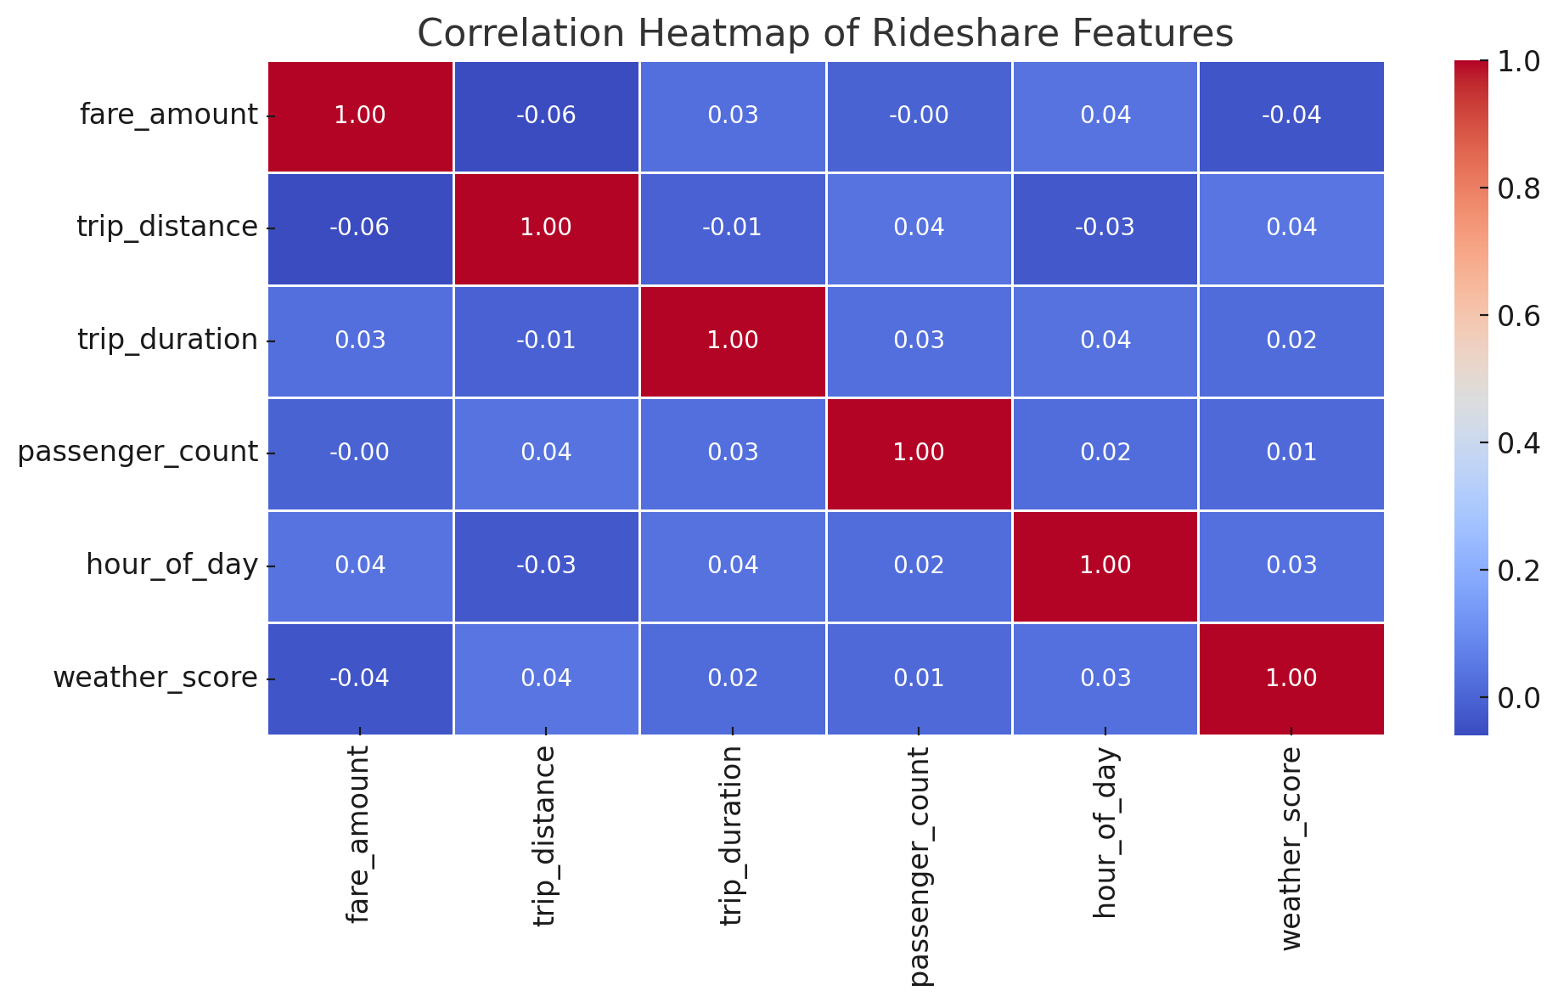
Exploratory Data Analysis (EDA)
Shows relationships between rideshare features.
All values are near zero weak or no correlation.
No strong link between fare, distance, duration, or other variables.

Slide 7

Modeling / Analysis Techniques
Algorithms:
Linear Regression: Simple baseline model.
Random Forest & XGBoost: Handle complex patterns.
Neural Networks: Ideal for large, non-linear data.
SVM & KNN: Alternative methods for comparison.
Evaluation Metrics:
MAE, RMSE: Measure prediction errors.
R²: Indicates model fit.
MAPE: Percentage error metric.

Slide 8
Results
Best Models: XGBoost & Random Forest outperformed others with low RMSE & MAE.
Key Findings: Distance, time of day, & ride type were the most important features.
Model Accuracy: R² ~ 0.85, indicating strong price prediction.
Impact: Models offer insights for dynamic pricing and decision-making.

Slide 9

Conclusion & Recommendations
Insights: Distance, time, & ride type are key predictors of price.
Recommendations: Implement dynamic pricing based on demand & location.
Business Impact: Improves pricing strategies and revenue.
Improvements: Add weather, traffic, & events for better accuracy.
With More Data: Explore time-series forecasting & personalized pricing.

Slide 10


